Slide 1
Lecture 1 – Camera Basic
Presented by Peihao Wang

Slide 2
Pin-hole Camera

Slide 3
Let’s design a camera
Idea 1: put a piece of film in front of an object
Do we get a reasonable image?
Slide by Steve Seitz

Slide 4
Pinhole camera
Idea 2: add a barrier to block off most of the rays
This reduces blurring
The opening known as the aperture
Slide source: Seitz
Notes:
Q: How does this transform the image? A: It gets inverted

Slide 5
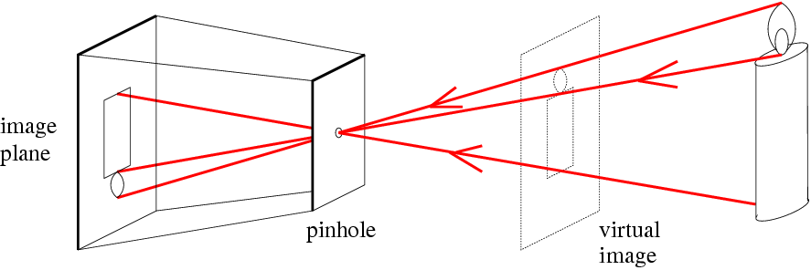
Pinhole camera
f
c
f = focal length
c = center of the camera
Figure from Forsyth

Slide 6
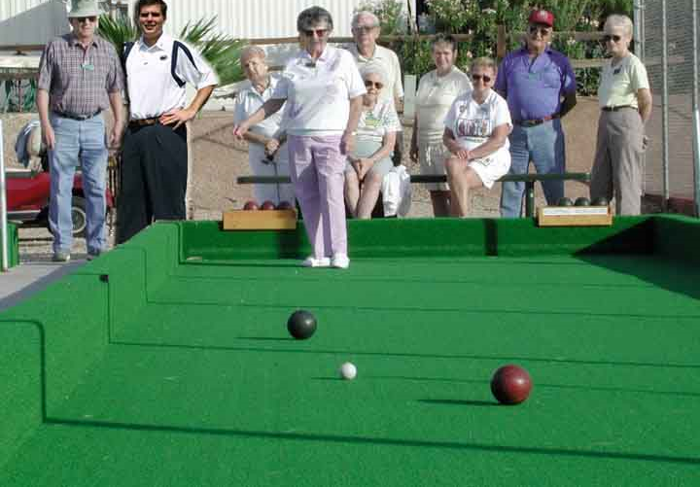
Projective Geometry
What is lost?
Length
Angles
Parallel?
Perpendicular?

Slide 7
Projective Geometry
What is preserved?
Straight lines are still straight

Slide 8
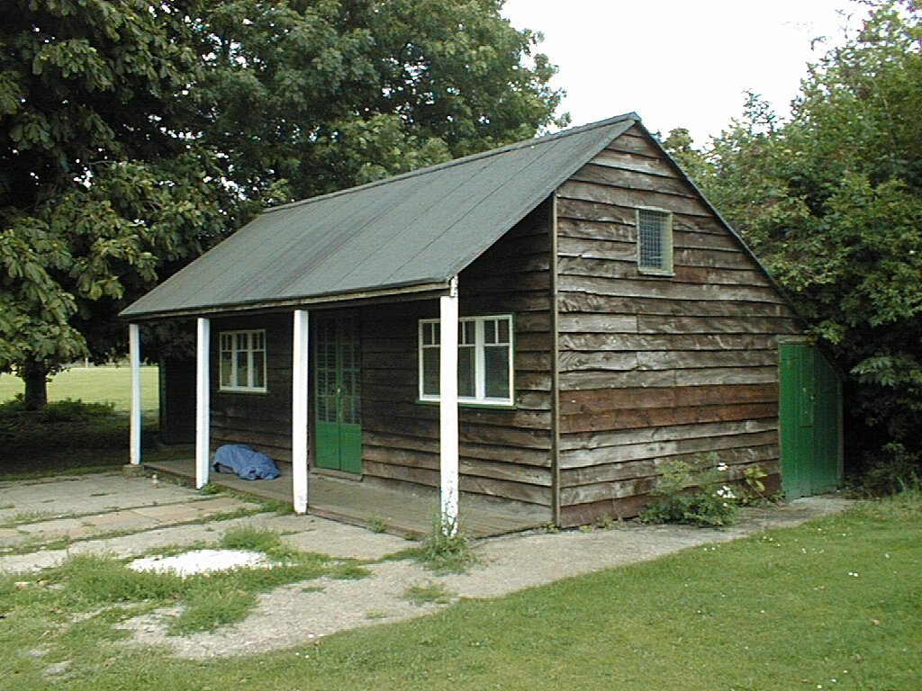
Vanishing points and lines
Vertical vanishing
point
(at infinity)
Vanishing
line
Vanishing
point
Vanishing
point
Slide from Efros, Photo from Criminisi

Slide 9
Perspective Projection (pinhole projection)

Slide 10
Intrinsic Parameters

Slide 11
Point at normalized image plan

Slide 12
Intrinsic Parameters
The coordinates (x, y) of the image point p are expressed in pixel units ( not meters).
Pixels may be rectangular instead of square(skewed).
The center of the CCD matrix usually does not coincide with the image center c₀
Due to manufacturing error, the angle between two image axes is not 90 degrees.

Slide 13
Intrinsic Parameters
Putting all equations together, we get
Here is called (Internal) calibration matrix of the camera.
Intrinsic parameters:

Slide 14
Extrinsic Parameters:
Camera coordinate frame:C
World coordinate frame:W
Taking P = ^{W}P

Slide 15
Degrees of freedom
p
P
5
6
Notes:
How many known points are needed to estimate this?

Slide 16
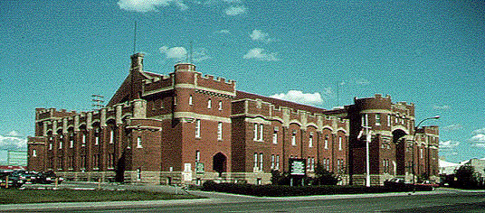
Vanishing points in Pinhole
H
VPL
VPR

Slide 17
Lens

Slide 18
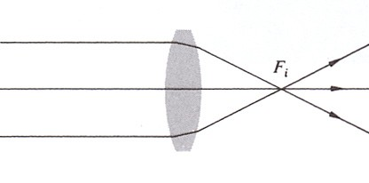

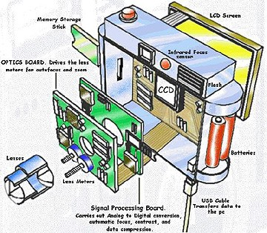
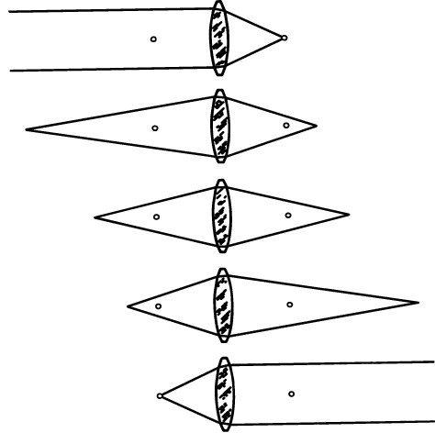
Cameras and their lenses
digital still camera (DSC),
i.e. point-and-shoot

Slide 19
From Gauss’s ray construction to the Gaussian lens formula
f (positive is to right of lens)
object
image
y_{o}
y_{i}
s_{o}
s_{i}
1 1
s_{o} s_{i}
y_{i}
s_{i}
y_{i}
s_{i} − f
1
+ =
f
and
.....
=
=
y_{o} s_{o}
y_{o}
f

Slide 20
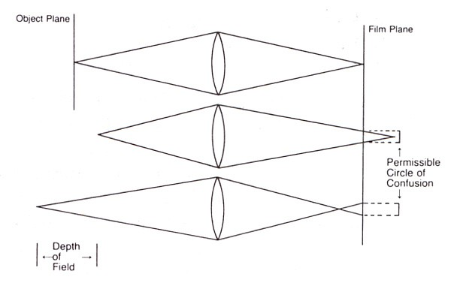
Circle of confusion (C)
C depends on sensing medium, reproduction medium, viewing distance, human vision,...
for print from 35mm film, 0.02mm (on negative) is typical
for high-end SLR, 6µ is typical (1 pixel)

Slide 21
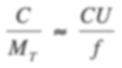

Depth of field formula
f
f
C CU
N =
≈
A
M_{T} f
depth of field
C
f N
depth of focus
D₂
D₁
U
object
image
D U − D
NCU ²
NCU ²
1
CU / f
=
1
..... D =
D =
1
_{f} 2
2
_{f} 2
f / N
NCU
NCU
55

Slide 22
Depth of field formula
2NCU ² f ²
^{D}TOT
= D₁ + D₂ =
_{f} 4
N ²C ²U ²
N ²C ²U ² can be ignored when conjugate of circle of confusion is small relative to the aperture
2NCU ²
_{f} 2
^{D}TOT
≈
where
N is F-number of lens
C is circle of confusion (on image)
U is distance to in-focus plane (in object space)
f is focal length of lens

Slide 23

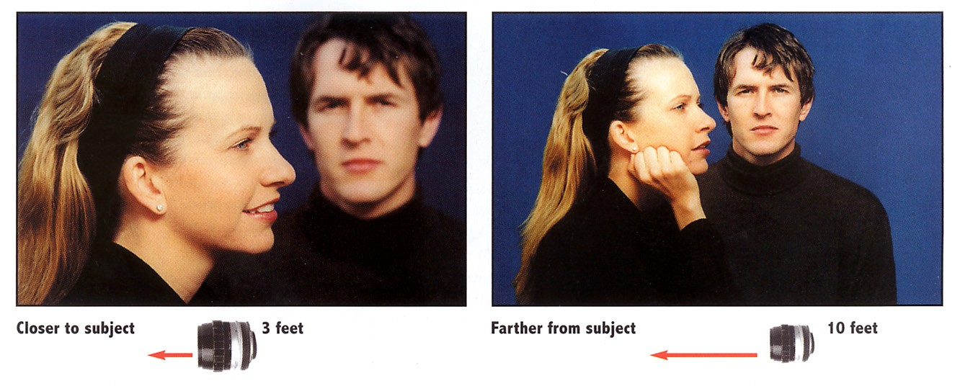
DoF is quadratic with subject distance
2NCU ²
^{D}TOT
≈
f
2

Slide 24
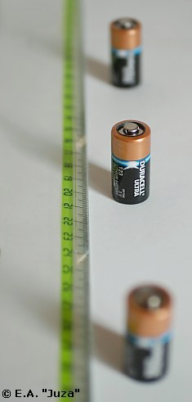
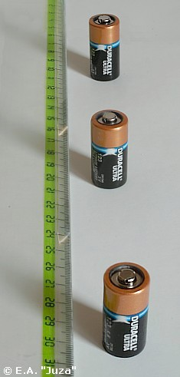
DoF is linear with F-number
2NCU ²
^{D}TOT
≈
_{f} 2

Slide 25
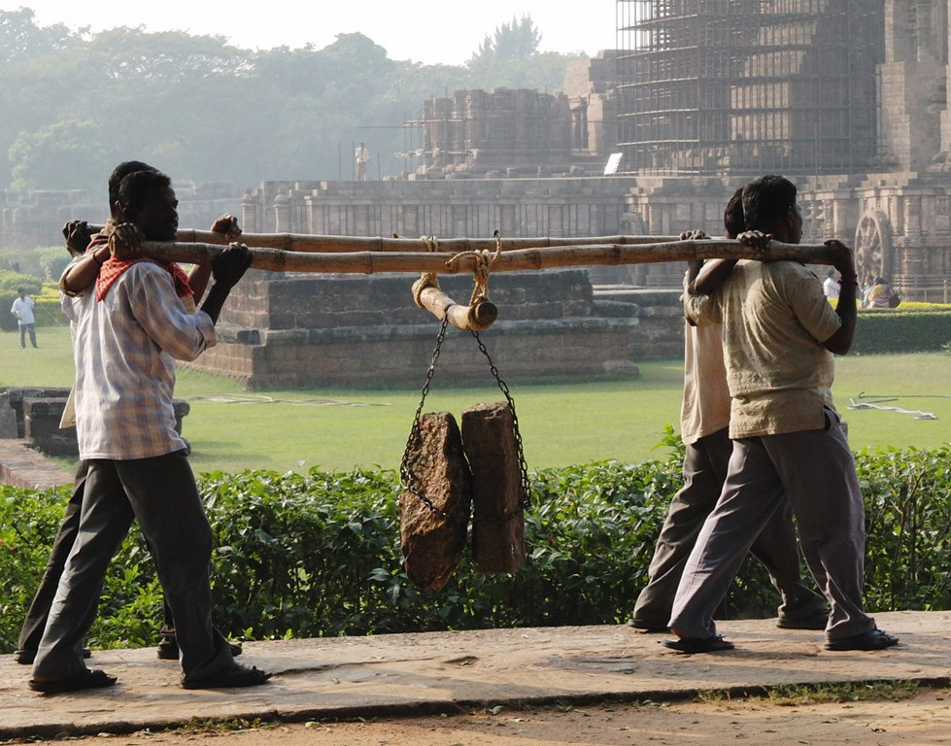
Hyperfocal distance
the back depth of field
NCU ²
◆
D₂ =
_{f} 2
NCU
◆
becomes infinite if
_{f} 2
U ≥ = H
NC
◆
In that case, the front depth of field becomes
NCU ² H
D₁ =
=
2
f + NCU 2
◆
so if I had focused at 32m, everything from 16m to infinity
would be in focus on an HD projector, including the men at 17m

Slide 26



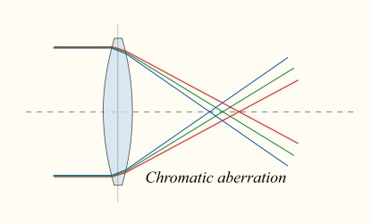
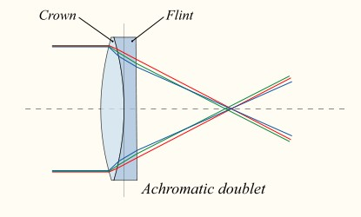
Chromatic aberration
red and blue have the same focal length
dispersion causes focal length to vary with wavelength
for convex lens, blue focal length is shorter
correct using achromatic doublet
strong positive lens + weak negative lens = weak positive compound lens
by adjusting dispersions, can correct at two wavelengths

Slide 27

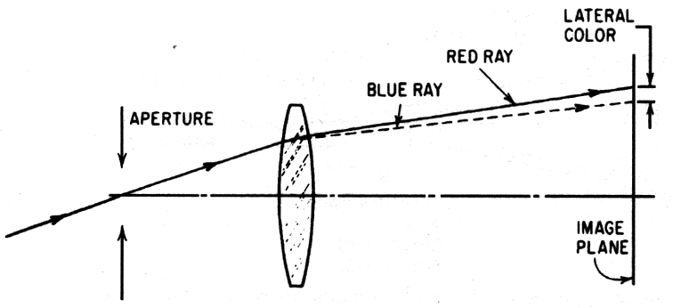
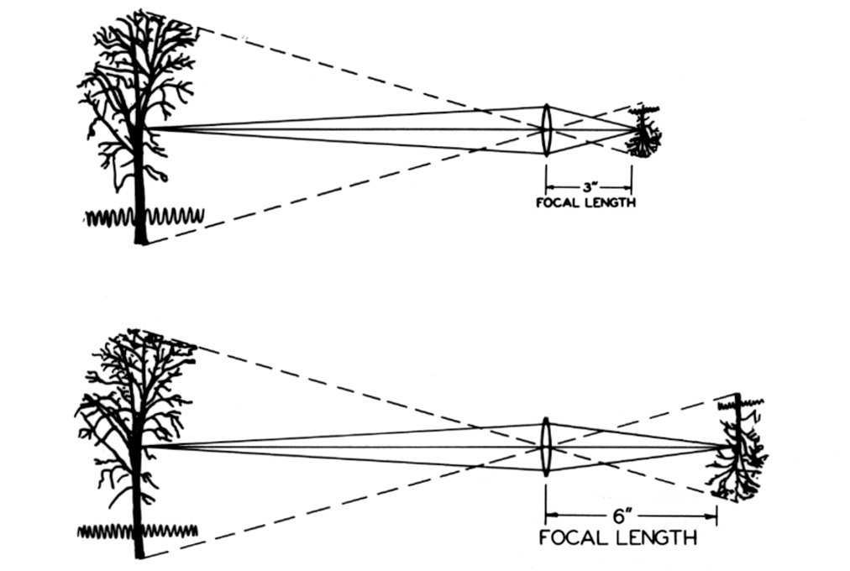
The chromatic aberrations
longitudinal (axial) chromatic aberration
different colors focus at different depths, creating colorful bokehs
appears everywhere in the image
lateral (transverse) chromatic aberration
if blue image is closer to lens, it will also be smaller
only appears at edges of images, not in the center
can reduce longitudinal by closing down the aperture

Slide 28

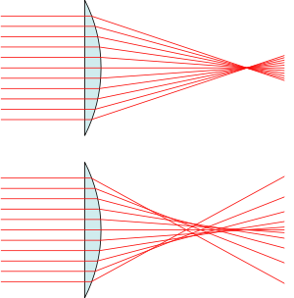
Spherical aberration
hyperboloidal lens
focus varies with ray height (distance from optical axis) can reduce by stopping down the aperture
can correct using an aspherical lens
✦
✦
✦
spherical lens

Slide 29

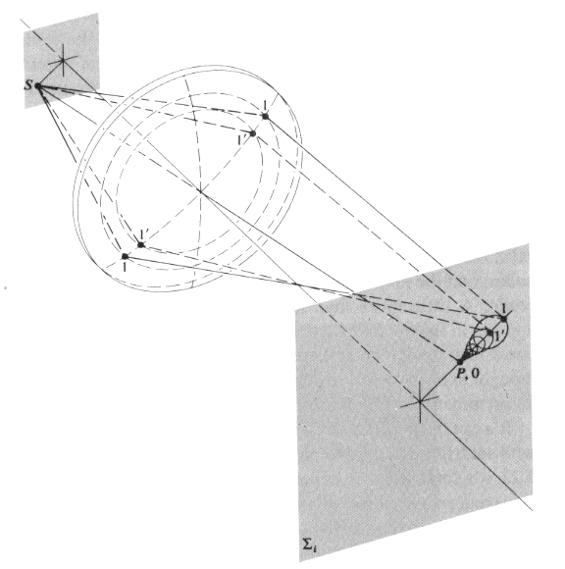
Coma
✦ magnification varies with ray height (distance from optical axis)

Slide 30
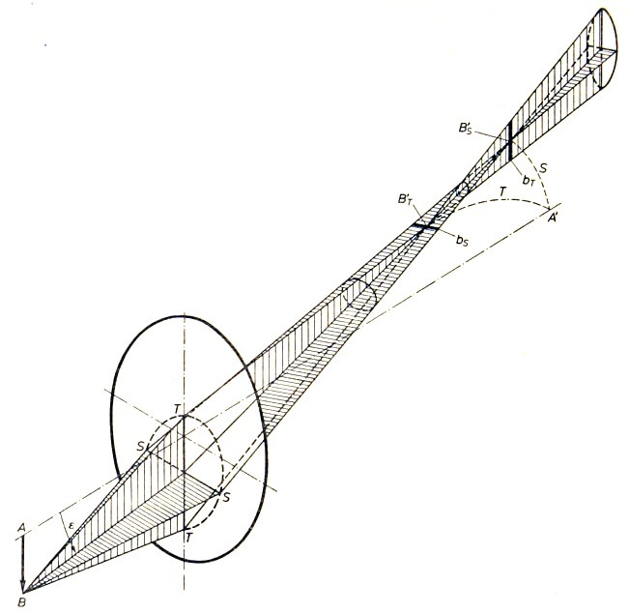
Astigmatism
focus of sagittal rays focus of transverse rays
(Pluta)
transverse and sagittal rays focus at different depths

Slide 31

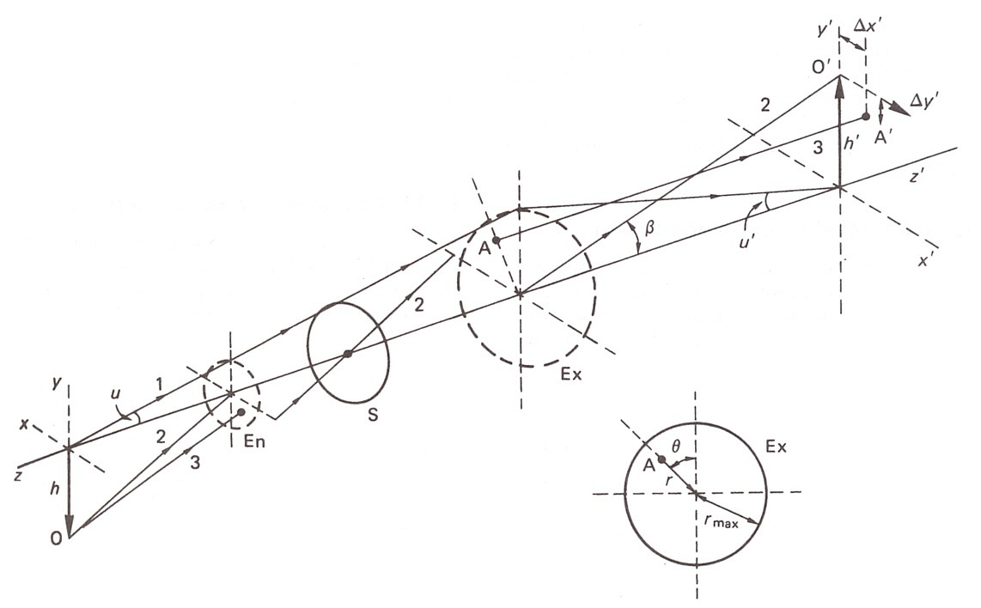
Algebraic formulation of monochromatic lens aberrations
spherical aberration a r⁴
s
coma a h ' r³ cosθ
c
_{a} 2 2 2
_{a}h ' r cos θ
_{a} 2 2
_{d}h ' r
3
✦ astigmatism
✦ field curvature
✦ distortion
a h ' r cosθ
t

Slide 32




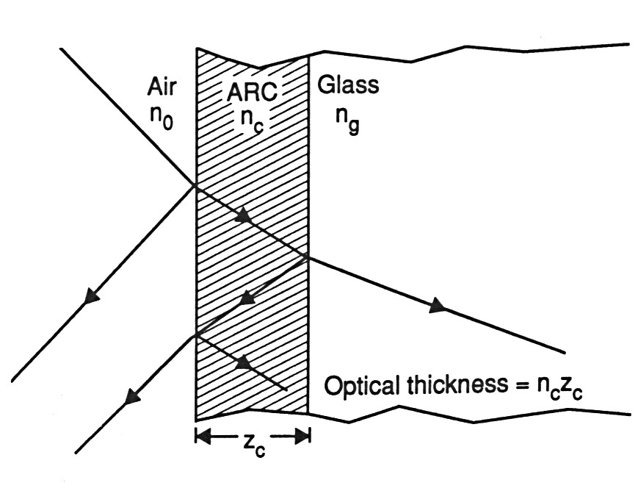

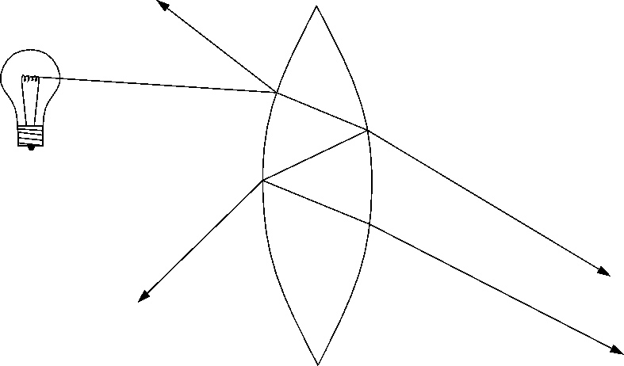
Veiling glare
in the outermost lens we don’t care about killing this reflection
but we do care about killing this one
contrast reduction caused by stray reflections
can be reduced by anti-reflection coatings

Slide 33

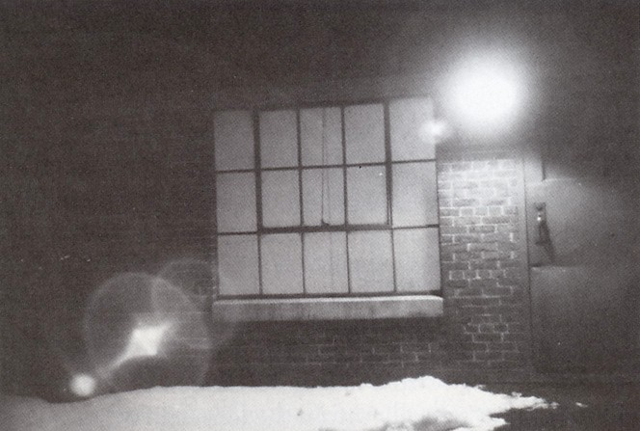

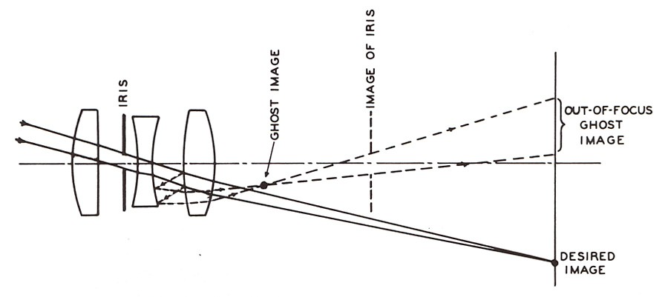
Flare and ghost images
reflections of the aperture, lens boundaries, etc.,
i.e. things inside the camera body

Slide 34

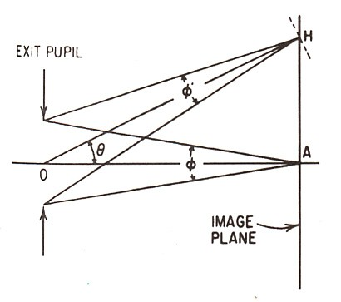
Vignetting
✦
irradiance is proportional to projected area of aperture as seen from pixel on sensor, which drops as cos θ
irradiance is proportional to projected area of pixel as seen from aperture, which also drops as cos θ
irradiance is proportional to distance² from aperture to pixel, which rises as 1/cos θ
✦
✦
✦
combining all these effects, light drops as cos⁴ θ

Slide 35

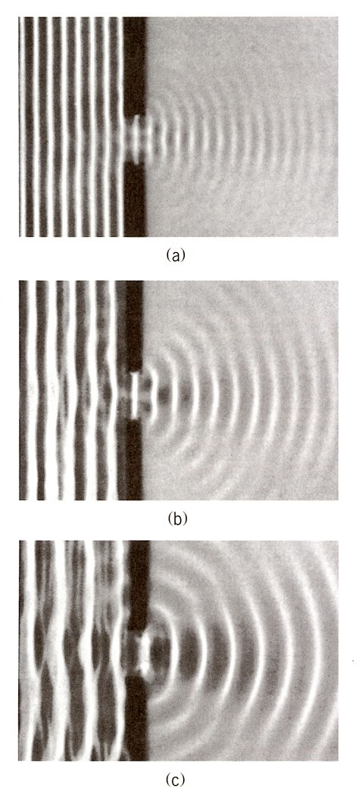
Diffraction in photographic cameras
well-corrected lenses are called
diffraction-limited
the smaller the aperture (A) (or the longer the wavelength), the larger the diffraction blur
the longer the distance to the sensor ( f ), the larger the blur when it gets there
thus, the size of the blur varies with N = f / A

Slide 36
Digital Camera

Slide 37
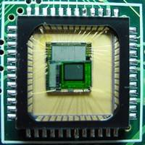

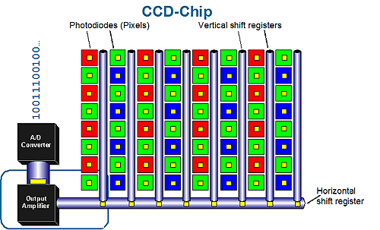
Sensor Array
CMOS sensor
Each sensor cell record a small range of orientations
amount of light coming in

Slide 38
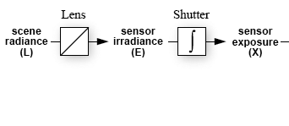
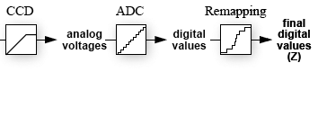
From light rays to pixel values
Camera response function: the mapping f from irradiance to pixel values
Useful if we want to estimate material properties
Enables us to create high dynamic range images
For more info: P. E. Debevec and J. Malik, Recovering High Dynamic Range Radiance Maps from Photographs, SIGGRAPH 97
Notes:
Chakrabarti, Scharstein, and Zickler (BMVC 2009) on the remapping process:
“the camera modiﬁes the tristimulus values so that they ﬁt
within the limited gamut and dynamic range of the output color space, and it does so in a way
that is most visually pleasing (as opposed to most accurate). Referred to as color rendering,
this is a proprietary art that may include luminance histogram analysis, corrections to hue
and saturation, and even local corrections for things such as skin tones. In most cases,
this nonlinear color rendering process is scene-dependent and is not a ﬁxed property of a
camera.”

